Slide 1

Smart Ring Spinning Optimization in Textile Industry
Group No: 41
Project Advisor: Dr. Ubaid Ullah Fayyaz
Department of Electrical Engineering,
University of Engineering and Technology, Lahore
Undergraduate Final Year Project Presentation
Dated: 20th October, 2021

Slide 2
Team Introduction
Saqib Nisar
2017-EE-045
Specialization: Computing
Muhammad Suleman
2017-EE-166
Specialization: Computing
Muhammad Usman Khan
2017-EE-187
Specialization: Computing
Usama Amir
2017-EE-043
Specialization: Power
Undergraduate Final Year Project Presentation
Dated: 20th October, 2021

Slide 3
Problem Statement
The main problem concern in textile Industry is a thread break while bobbin build up.
End break detection is only possible if a staff member detects that end breaks as soon as possible.
Also due to end break, there is no control over the yarn delivery rollers unless the staff member figure that out.
Undergraduate Final Year Project Presentation
Dated: 20th October, 2021

Slide 4
Proposed Solution
The product that we will make will measure and control the critical parameters in ring spinning.
End-break detection with our product is the starting point for best-practice in optimization.
After break detection, the data of bobbin is analyzed through programming and emergency light will glow that will show that the thread is broken.
Undergraduate Final Year Project Presentation
Dated: 20th October, 2021

Slide 5
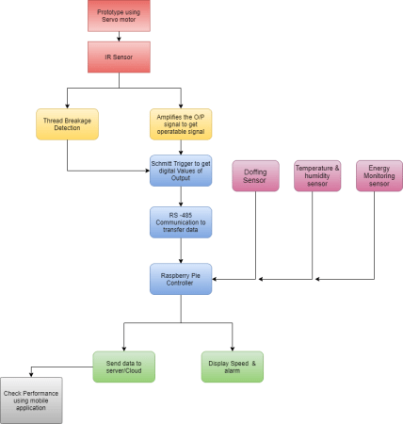
Block Diagram
Undergraduate Final Year Project Presentation
Dated: 20th October, 2021

Slide 6
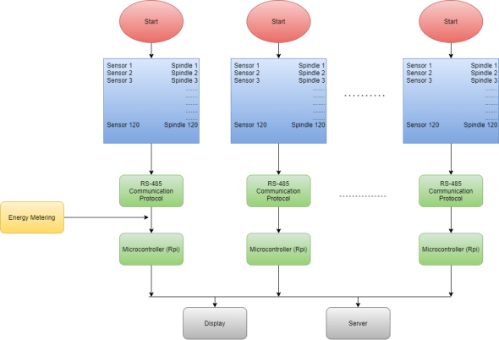
Flow Diagram
Undergraduate Final Year Project Presentation
Dated: 20th October, 2021

Slide 7
Applications
Increase Yield of industry
Workload on staff members decrease
No need of periodical maintenance
Undergraduate Final Year Project Presentation
Dated: 20th October, 2021

Slide 8
Audience
Target Audience will be all textile industries of Pakistan.
Complete Working prototype will be made at the end and its working will be demonstrated in the industries.
Undergraduate Final Year Project Presentation
Dated: 20th October, 2021

Slide 9
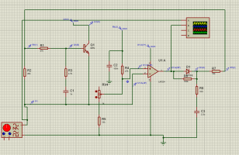
Simulation
Stages
Three major stages of circuit for thread break detection:
Stage 1 (Signal Conditioning Circuit)
Stage 2 (Inverting Amplifier Circuit)
Stage 3 (Schmitt Trigger Circuit)
Stage 1 (Signal Conditioning Circuit)
Common Emitter Component
Comparator Component
Low Pass Filter Component
Undergraduate Final Year Project Presentation
Dated: 20th October, 2021

Slide 10
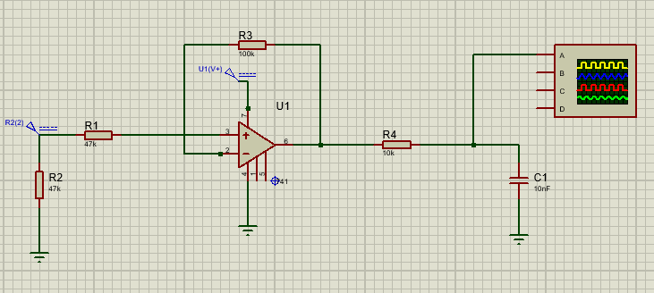
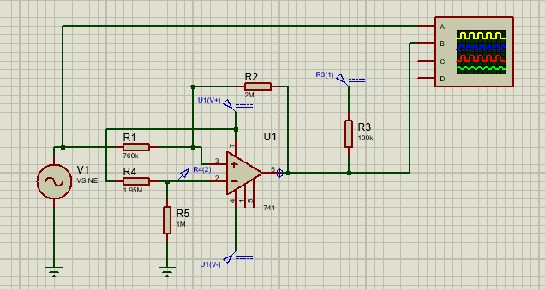
Simulation
Stage 2 (Inverting Amplifier Circuit)
Amplify the detecting signal
Standard gain achieved
Low Pass Filter
Stage 3 (Schmitt Trigger Circuit)
Upper and Lower Threshold
Remove Any type of noise
Square wave obtain of varying frequency
Undergraduate Final Year Project Presentation
Dated: 20th October, 2021

Slide 11
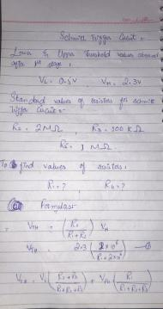
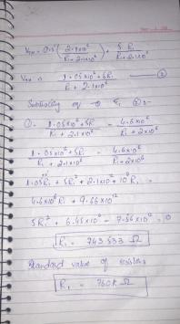
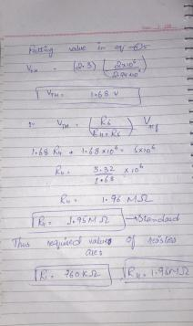
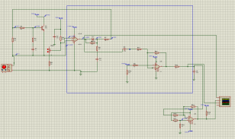
Simulation & Calculation
Schmitt Trigger Calculations and Complete Circuit
Undergraduate Final Year Project Presentation
Dated: 20th October, 2021

Slide 12
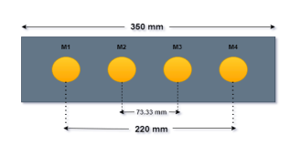
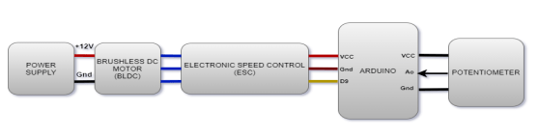
Hardware Developed
Motor Design:
A2212/ T10 1400kV BLDC Motor
Max. Efficiency Current: 6-12A
Max. Watts: 180W
Max Efficiency: 80%
Prototype Setup:
12V power supply
BLDC
ESC
Arduino
potentiometer
Undergraduate Final Year Project Presentation
Dated: 20th October, 2021

Slide 13
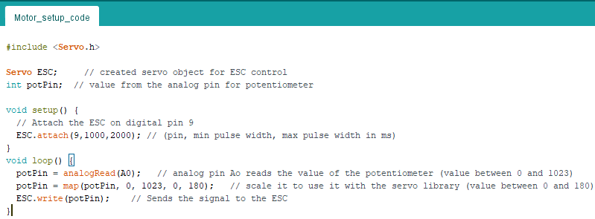
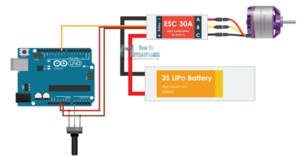
Hardware Developed
Arduino Code for the Motor Setup:
The following code configures the motor setup including power supply, BLDC, ESC, Arduino and potentiometer.
Undergraduate Final Year Project Presentation
Dated: 20th October, 2021

Slide 14
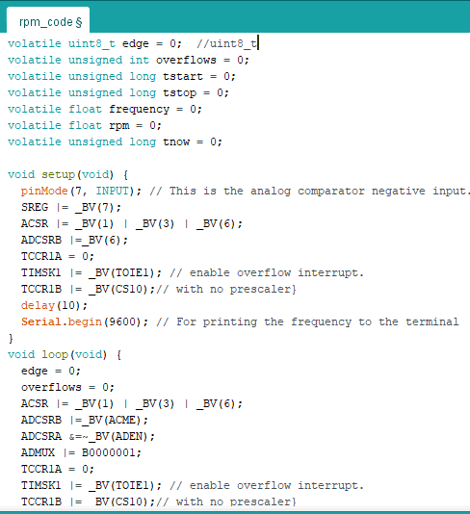
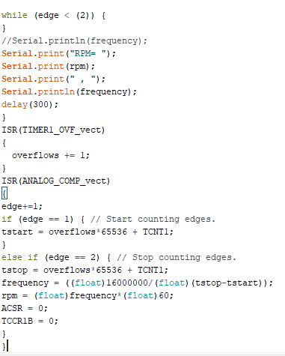
Hardware Developed
Arduino Code for RPM calculation:
The following code
determines the rpm
and frequency of the
prototype e.g.
motor setup->IR sensor
->signal conditioning->
amplifier-> comparator
Undergraduate Final Year Project Presentation
Dated: 20th October, 2021

Slide 15
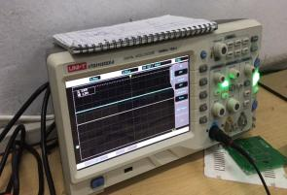
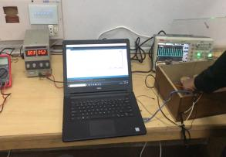
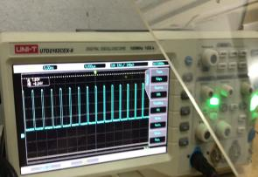
Hardware Developed
Prototype Final Testing:
The final step in hardware was final testing of the prototype. The circuit was patched, motor was started and the Arduino codes helped us find the frequency and rpm of the spinning prototype.
Undergraduate Final Year Project Presentation
Dated: 20th October, 2021

Slide 16
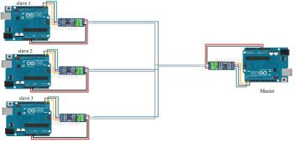
Software Developed
Master/Slave Nomenclature
In our project, the rpm of each spindle is recorded by micro-controller called Slave.
Four spindles are connected to one slave and 24 slaves are connected to one micro-controller called Master.
This whole network of Master/Slave is connected in Modbus configuration and RS-485 protocol is followed for the communication.
Four master controllers are joined with one R-pi to gather all the data and upload it to cloud.
The Master acts according to slave data and notify the operator about the fault
Figure: Modbus
Undergraduate Final Year Project Presentation
Dated: 20th October, 2021

Slide 17
Serial Communication
The communication between master and slaves is serial with baud rate of 9600
Master sends request to each slave which comprises of the slave id and function code
Upon matching with the id, the directed slave sends it data, rpm and timestamp, in byte array/data frame
The data frame/byte array varies according to the function code in master’s request i.e. what data is requested from the salve
Master repeats this process after every 0.5s
Undergraduate Final Year Project Presentation
Dated: 20th October, 2021

Slide 18
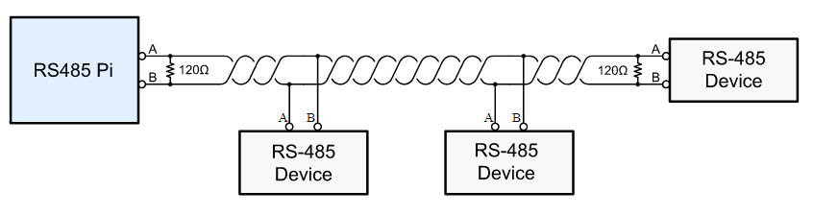
Master – R-Pi Communication
R-Pi is used to transferred data to Cloud
4 Masters are connected to 1 R-Pi
Protocol used for Communication is RS485
Undergraduate Final Year Project Presentation
Dated: 20th October, 2021

Slide 19
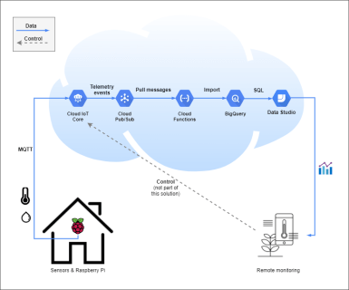
R-Pi to Cloud
MQTT is used to transfer
data from R-Pi to Cloud
It is lossless, bi-directional
and ordered protocol
It takes data from R-Pi
and deliver it to a single place
Undergraduate Final Year Project Presentation
Dated: 20th October, 2021

Slide 20
Future Deliverables
Adding more functional code to slave’s code e.g. to set the initial id’s at reset, acquiring duration of yarn breakage from slave etc..
Allotting separate ids to spindles in order to correctly identify the fault
Customizing Arduino-mini to be used with limited area and ports in our project
Undergraduate Final Year Project Presentation
Dated: 20th October, 2021

Slide 21
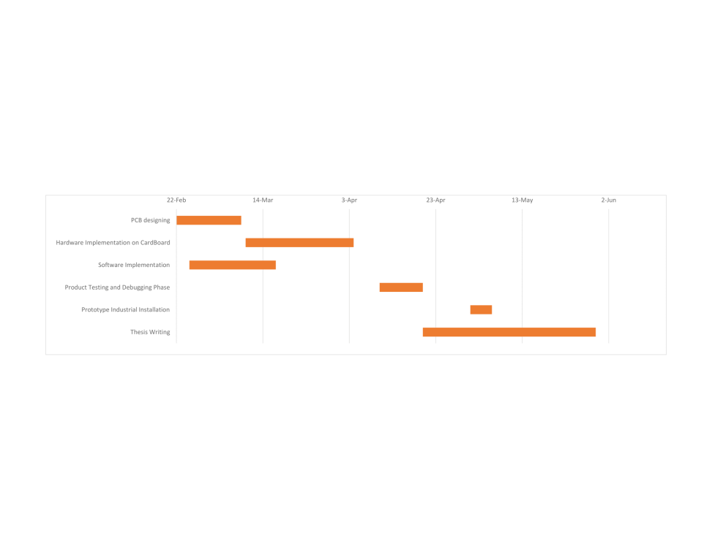
Gantt Chart
Undergraduate Final Year Project Presentation
Dated: 20th October, 2021

Slide 22
References
M Hossain, A Abdkader, A Nocke, R Unger, F Krzywinski, MMB Hasan, and Chokri Cherif. Measurement methods of dynamic yarn tension in a ring spinning process. Fibres & Textiles in Eastern Europe, 2016.
RZtronics and Instructables. Control brushless motor using arduino, Sep 2017. URL https://www.instructables.com/ Control-Brushless-Motor-Using-Arduino/.
Lammert Bies © 1997-2019. Rs485, specifications and in depth tutorial. URL https://www.lammertbies.nl/comm/info/rs-48
Qingguang Chen, Lingyun Xue, and Huanle Rao. Rotational speed measurement of ring spinning based on magnetic sensor. Measurement Science and Technology, 28(11):115106, 2017.
Undergraduate Final Year Project Presentation
Dated: 20th October, 2021

